Slide 1


Intro to Self-Funding
February 4, 2026

Slide 2

Outline
Fully Insured (FI)
Self-Funding (SF)
FI vs. SF Comparison
Components of Self-Funding
Fees of Self-Funding
Reinsurance (stop-loss) Risk Mitigation
Case Study
Addendum

Slide 3
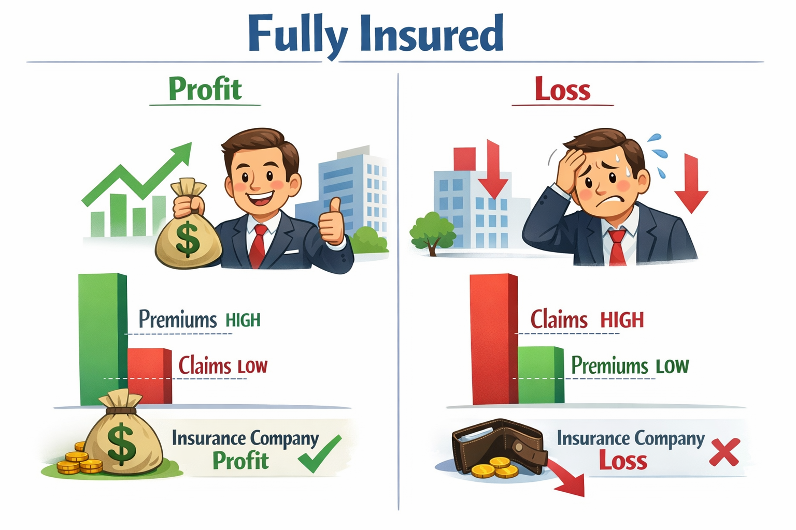
Fully Insured (FI)
How it works
Employer pays a fixed monthly premium to an insurance carrier
The carrier pays all medical claims and assumes all risk
Any unused premium is kept by the carrier as profit
Key factors
Monthly cost is predictable
Limited access to claim details
Employer outcome
Risk is capped at the premium paid
Poor claims experience leads to large renewal increases
Carrier keeps profit in good claim experience periods

Slide 4
Self-Funded (SF)
How it works
In a self-funded plan, the employer functions as the insurance company
Employer pays claims [weekly] as they occur instead of paying fixed premiums
Employer hires carriers/TPAs to administer the plan
Key factors
More transparency in utilization and spend
More control of the plan
Costs vary from month to month (due to claims)
Employer outcome
Employer owns both the financial upside and the downside (with protection)
  Retain profits with favorable healthcare consumption, but greater financial stakes in poor claim years.

Slide 5
FI vs. SF Comparison
Fully Insured | Self-Funded
Pay fixed premiums | Pay claims as they happen
Insurance company owns risk | Client takes risk (with mitigation)
Less transparency | More transparency
Predictable costs | Variable costs

Slide 6
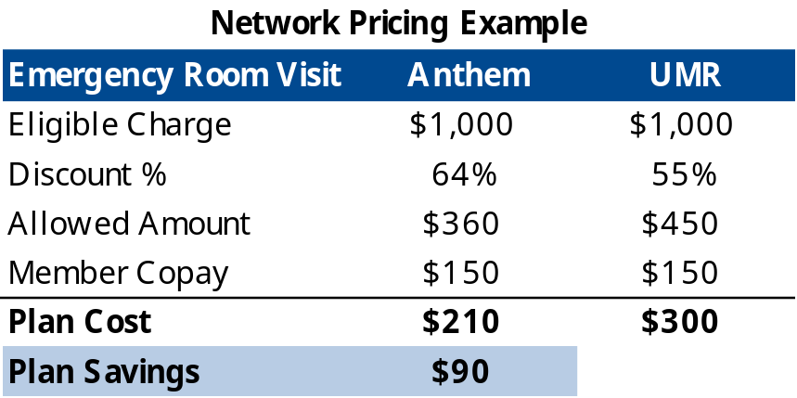
Components of Self-Funding
Administrator (Carrier ASO or TPA)
Carrier Administrative Services Only (ASO) – Anthem, UMR, etc. provide their own provider networks
Third-Party Administrators (TPA) – Point C, Ameriben, etc. rent other insurance carriers’ provider networks
Processes and adjudicates claims
Handles customer service and eligibility
Provides reporting and online tools
Provider Network
Negotiates pricing with doctors and hospitals
Network discounts directly impact plan cost
Pharmacy Benefit Manager (PBM)
Manages prescription drug claims if carved out → pharmacy is not bundled with the Carrier/TPA
Reinsurance (stop-loss)
Does not remove risk, but mitigates it

Slide 7
Fees of Self-Funding
Most fees are based on a composite Per Employee Per Month (PEPM) basis
Administrative services
Network access
  Can be included as a composite PEPM rate or as a percentage of claims, capped at a PEPM max or collected at a PEPM min.
PBM services
Stop-loss premiums
Common “optional” programs
Nurse Line
Disease management
Telemedicine
Clinical programs
Pharmacy Benefit Manager (PBM) carve out fee – composite PEPM
Reinsurance (stop-loss) – Composite, 2-tier (Single/Family) or 4-tier (EE/SP/CH/Fam) rates.

Slide 8
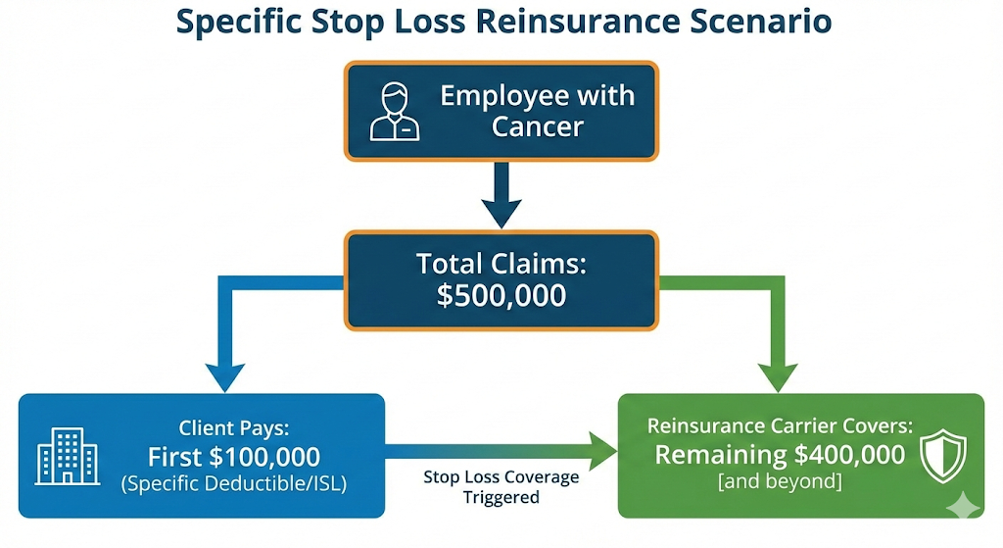
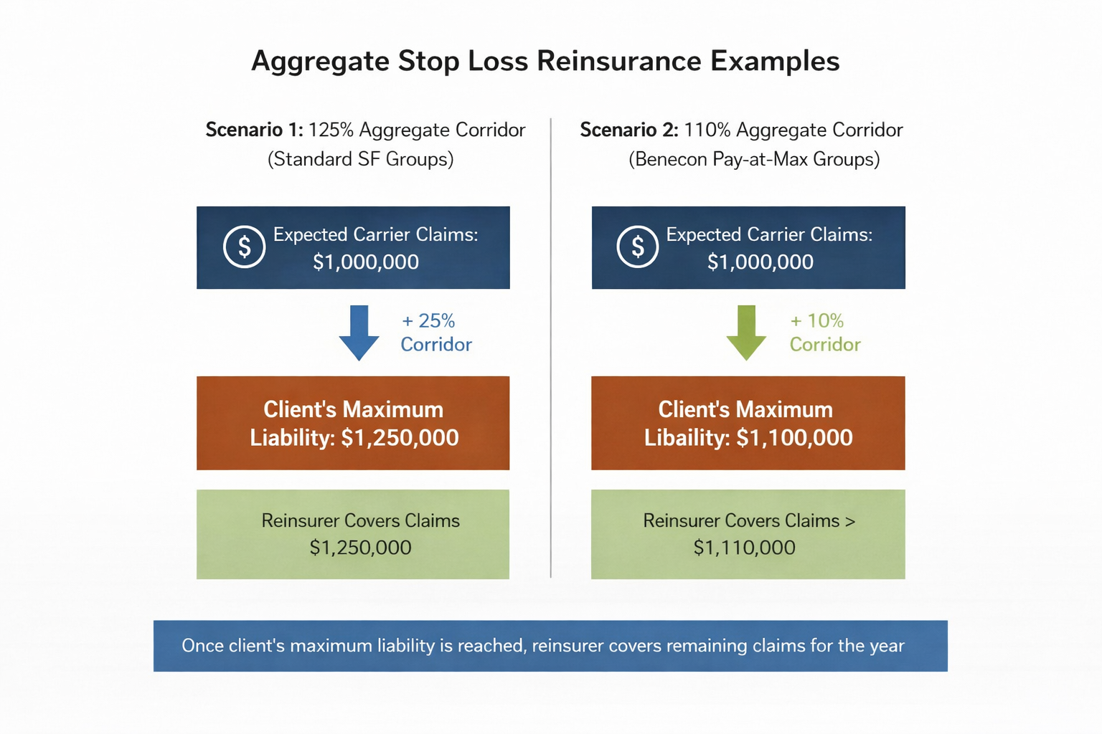
Reinsurance (stop-loss) – Risk Mitigation
Specific Reinsurance
Individual level protection (high cost claimant insurance)
Employer pays claims up to a set deductible
Carrier reimburses amounts above that deductible
Premium varies based on deductible level, the lower the deductible, the higher the premium. The higher the deductible, the lower the premium.
Aggregate Reinsurance
Group/plan level protection (utilization insurance)
Based on expected claims plus and aggregate corridor
Typically reimburse the plan up to $1M.
Premium will vary on group size and aggregate corridor %.
  Lower premium – larger group size = less variability in claims and/or higher aggregate corridor.
  Higher premium – smaller group size = less predictable claims and/or lower aggregate corridor.

Slide 9

Case Study

Slide 10
Addendum
1. How to Think About Self-Funding
In a self-funded plan, the employer is the insurance company, and everyone else plays a supporting role.
Roles at a Glance
Employer: Owns the plan, pays claims, sets benefits, retains risk
TPA: Administers the plan and adjudicates claims according to plan rules
Provider Network: Supplies contracted pricing for care
PBM: Administers prescription drug benefits (if carved out)
Stop-Loss Carrier: Limits the employer’s downside risk
Broker/Consultant: Advises on structure, risk tolerance, and strategy
How Money Moves
Claim dollars always originate from the employer’s plan account
The TPA reviews claims and directs payment
Stop-loss reimburses the plan after deductibles are exceeded
Key Mental Shift (Fully Insured → Self-Funded)
Fully insured plans prioritize budget certainty. Self-funded plans emphasize cost efficiency with greater visibility into claims.
Self-funding does not reduce costs on its own; it shifts cost ownership, timing, and transparency to the employer.How it works
In a self-funded plan, the employer functions as the insurance company
Employer pays claims [weekly] as they occur instead of paying fixed premiums
Employer hires carriers/TPAs to administer the plan
Key factors
More transparency in utilization and spend
More control of the plan
Costs vary from month to month (due to claims)
Employer outcome
Employer owns both the financial upside and the downside (with protection)
  Retain profits with favorable healthcare consumption, but greater financial stakes in poor claim years.

Slide 11
Addendum (Continued)
2. Practical Glossary (Plain-English Definitions)
Administrative Services Only (ASO)
An arrangement where a carrier or TPA administers claims but does not insure risk.
PEPM (Per Employee Per Month)
The standard pricing unit for administrative fees and stop-loss premiums.
Specific Stop-Loss
Protection against catastrophic claims from a single individual. The employer pays claims up to the specific deductible; the carrier reimburses amounts above it.
Aggregate Stop-Loss
Protection against total plan claims exceeding a predefined annual threshold.
Aggregate Corridor
The percentage above expected claims that the employer is responsible for before aggregate stop-loss applies (e.g., 125%).
Laser
A higher specific deductible applied to a known high-cost individual.
Aggregating Specific Deductible
A requirement that total stop-loss reimbursements exceed a stated amount before stop-loss payments begin.
Expected Claims
An actuarial projection of what the plan is likely to pay during the year, used to price stop-loss and aggregates.
Plan Document
The legal rulebook governing what the plan covers and how claims are paid.

