Slide 1
Self-funding solved
Health Plan Consortium

Slide 2

Confidential Information
The following contains information related to the unique group purchasing approach of The Benecon Group. This cooperative model consists of risk sharing models and mathematical formulas that Benecon considers proprietary intellectual property.
By reviewing this presentation, it is understood that the holder of this information shall keep all ideas and concepts in strict confidence. Without the prior written consent of The Benecon Group, no one shall copy, reproduce or disclose in any manner any of the contents in this presentation to any third parties.

Slide 3
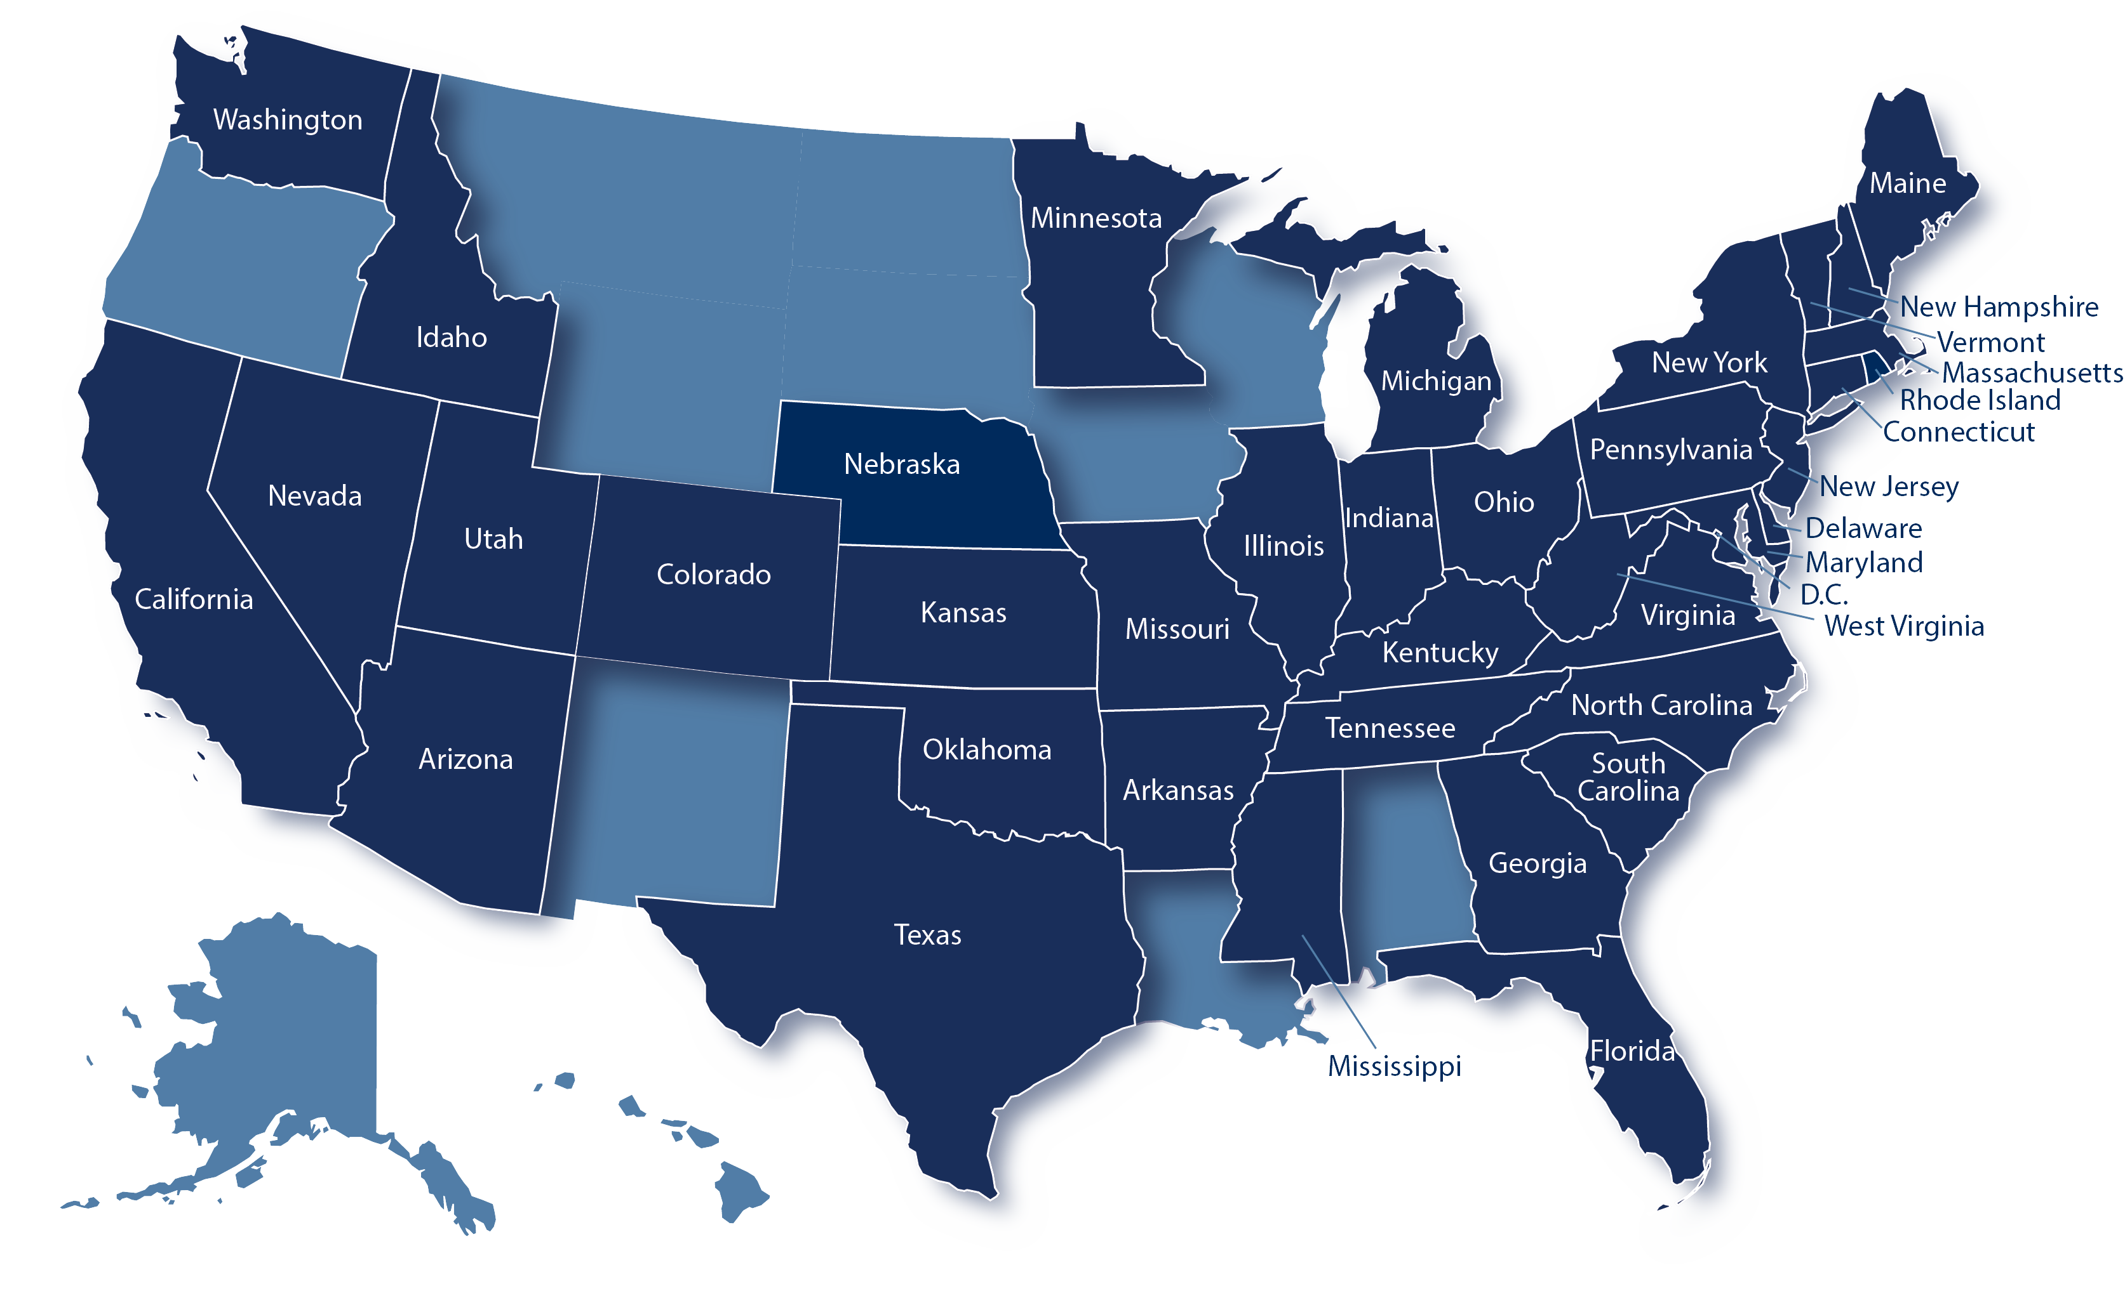
Who is Benecon?
The leader in developing and administering self-funded health insurance consortiums for over 30 years
$3.3B+ in total funding
2,105+ employer/member groups
240,875+ employees covered
$790M in total stop loss
*Quoting in all states; Benecon groups = dark blue

Slide 4















Group Purchasing Power

Slide 5
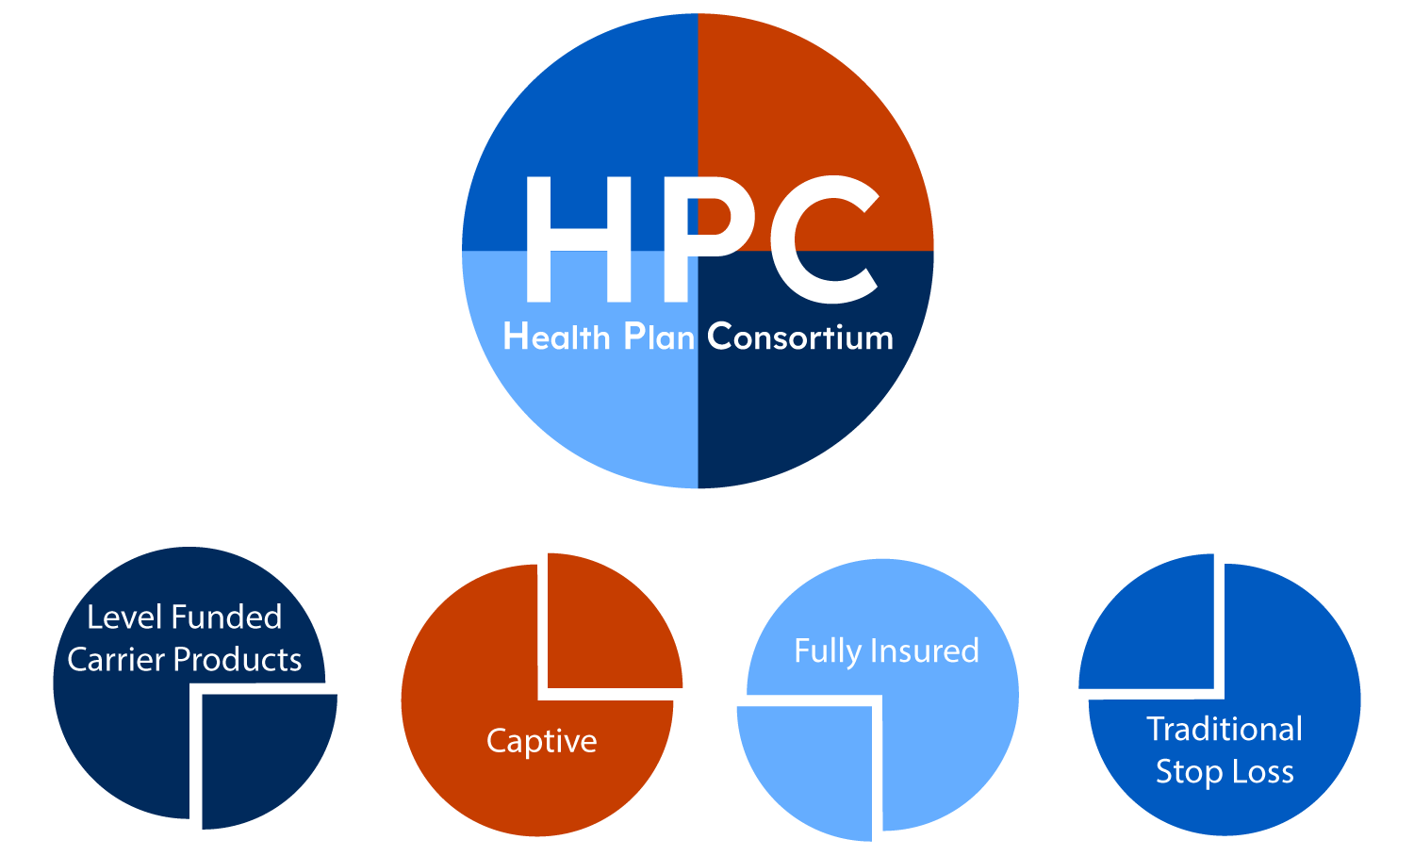
HPC pulls the positive elements from each funding type while eliminating the risks.

Slide 6

Benefits of Self-Funding with the Health Plan Consortium
Annual max funding guaranteed
Always renewable
Benecon independent actuaries develop the rates
100% claim payment
Plan administration is seamless to the employees
ConnectCare3, our sister company, provides health and wellness support
You retain 100% of surplus
Does not allow one group to subsidize another
100% transparency on all data and reporting
Retain full control over the benefits and network offered
No lasering at future renewals
State premium tax savings
Renewal Rate Caps on stop-loss and overall renewal

Slide 7

How it works
Health Plan Consortium renews 1/1 or 7/1 but you can enter at any time with either a short or long first year stop loss contract
Stop-loss insurance provides protection from individual large claims (specific) and overall claims (aggregate)
Both Specific and Aggregate Accommodations limit cash flow concerns
You deposit monthly premium equivalents into your individual claim fund(bank) account
All claims are deducted from the claim fund account

Slide 8
Review of the Health Plan Consortium Model
8%
Administrative Fund
Specific Stop Loss
23%
Claim Fund with Corridor
Aggregate Stop Loss
Pay claims under 50k from Claim Fund
$400,000
Member Surplus
Claim Fund Exhausted
Member Surplus
$$$
$$$

Slide 9
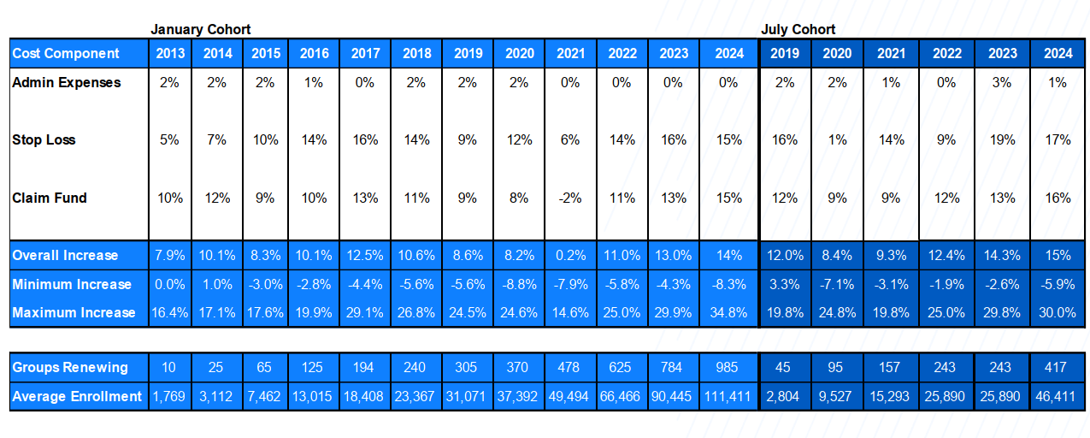
Redefining Renewals
Health Plan Consortium Renewal
Guaranteed Renewable Stop Loss
No New Lasers – in perpetuity
Rate Caps – Specific Stop Loss and Overall Renewal
Notes:
Didn’t update this yet 9/26

Slide 10






Health Plan Consortium Management & Support
Group Purchasing Power
Benecon Consortium Model leverages global stop loss volume
Rate Development
Independent actuaries set the rates, not the insurance carriers
Compliance Resources
DOL Audit prep and access to our team of experts
Financial Services
Monthly billing & enrollment; Coordination of carrier reimbursements and stop loss filings
Data Analytics
Detailed reports provide full claims data transparency
Health Care Navigation
ConnectCare3 provides Wellness Consulting & Clinical Services

Slide 11
The Benecon Compliance Review
Basic
Administrative carrier documents
Medical or MEGA WRAP documents if applicable
Fidelity Bond if applicable
Continuation/Leave or Absence Policy
Create or review other documents as needed (POP, FSA, HRA, additional WRAP documents)
Determine if Benecon is to file the 5500
One half hour phone call to discuss needed items at the beginning of the compliance process, if determined to be needed in addition to the implementation process.
Additional calls through process as needed.
Comprehensive
Administrative carrier documents
Medical or MEGA WRAP documents if applicable
Fidelity Bond if applicable
Continuation/Leave or Absence Policy
Create or review other documents as needed (POP, FSA, HRA, additional WRAP documents)
Determine if Benecon is to file the 5500
Review or creation of all documentation required by the Department of Labor during a health and welfare audit (see Compliance Review handout)
One initial two-hour fact gathering call to determine what is needed for the review process.
Two-hour delivery call at conclusion of the comprehensive review to go over compliance manual documentation and findings.
Additional calls through process as needed.
Total length of the comprehensive compliance review process is 5 months to 1 year. Follow up emails requesting needed items every 2-3 weeks throughout the process.

Slide 12

Robin Richardson
Senior Sales Director
rrichardson@benecon.com
888-400-4647

