Slide 1


Maximizing Employee Accountability & Engagement
Bethany Denning
October 2024

Slide 2


Command & Control vs Engage & Collaborate

Slide 3
“
Accountability is taking ownership of results and working to improve future results.
Michael Timms
Author, Speaker and Consultant

Slide 4


Slide 5
“
Leaders set the upper limit of accountability for their organization. No one will take accountability to a greater degree than their leader does.
Michael Timms
Author, Speaker and Consultant

Slide 6
Accountability Outcomes
Culture of Low Accountability | Culture of Accountability & Excellence
People who say, “That’s not my problem.” | Doing whatever it takes to achieve the desired results
Offering excuses and abandoning problems | Suggesting solutions they intend to carry out themselves
Finger pointing | Admitting mistakes
Lack of trust and cooperation | Going out of their way to assist colleagues
An “Us” vs “Them” mentality | Treating other departments like customers
Managers who don’t address poor performance | Managers who provide reaffirming and improvement feedback
Defensiveness to feedback | Requesting feedback
Constant firefighting mode | Integrating lessons learned into SOPs to continually improve outcomes
Missed deadlines and unachieved goals | Regularly reporting progress and mitigating obstacles to ensure goals are met
Zero consequences for results | Everyone feels the impact of success and failure
Timms, Michael. “Three Steps to Develop Personal Accountability.” www.availleadership.com.

Slide 7
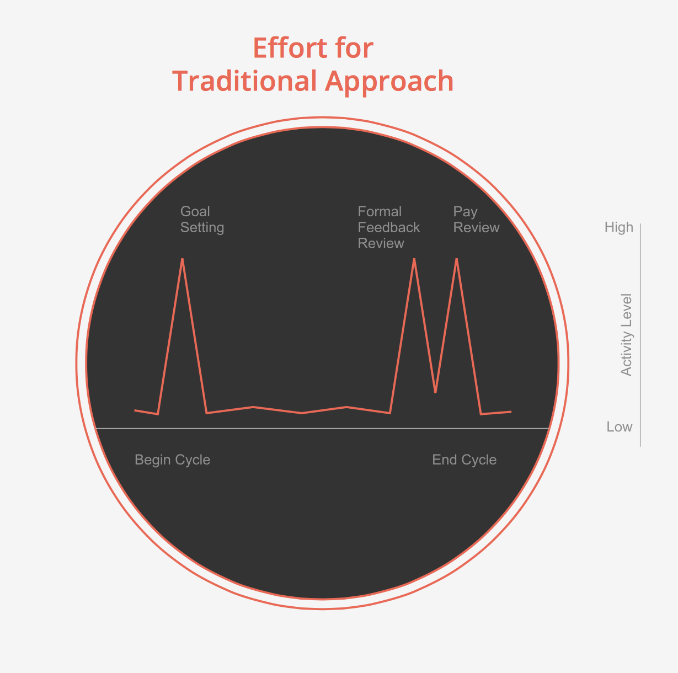
Traditional Approach to Performance Management
Annual cycle
Backwards looking
One-way dialogue
Top down
Rigid
HR tool
Source: Bersin by Deloitte performance management research

Slide 8
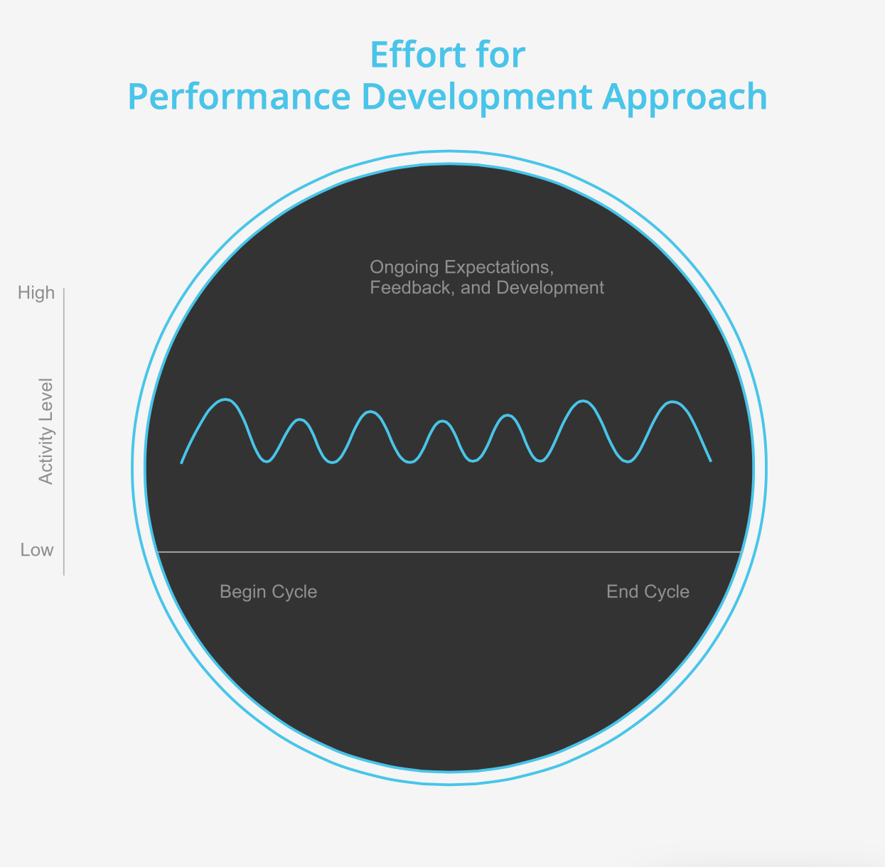
Continuous Performance Management
Effort for
Performance Development Approach
Effort for Continuous Performance Management
Flexible
Continuous feedback
Development-focused
Two-way dialogue
Future focus
Business tool
Source: Bersin by Deloitte performance management research

Slide 9






Continuous Performance Management Guiding Principles
Goal Alignment
Clear Expectations
Shared Accountability
Regular Performance
Discussions
Coaching & Feedback
Development Focused

Slide 10





Goal Alignment
Company Goals
Department Goals
Individual Performance Goals

Slide 11

Performance = What + How

Slide 12
Leadership Competencies
Cultivates Innovation
Inspires and Empowers Others
Encourages Continuous Growth & Development
Delivers Results
Fosters Trust & Transparency
Serve as the “How” portion of performance management
Clarify expectations regarding how leaders lead and behave
Provide a roadmap for hiring and developing future leaders
Provide a basis for promotion and recruiting decisions
Notes:
12

Slide 13
Competency Format
Competency:
Fosters Trust and Transparency
Follows through on commitments and holds others accountable for doing the same
Leads by example and walks the talk
Does the right thing even when no one is looking
Encourages open communication and information sharing
Knows when and how to share sensitive information with others
Descriptors:

Slide 14

Check-in conversations
Snapshot tool
Manager pulse survey

Slide 15
Accountability Cycle
Set clear expectations
Ensure clear capability
Clearly measure progress
Provide clear feedback
Provide clear consequences
Bregman, Peter. “The Right Way to Hold People Accountable.” HBR. January 11, 2016.

Slide 16
When Thinking about Accountability…
Remain focused on results, not tasks
Encourage leaders to model behaviors
Rethink how performance is managed

Slide 17


